Slide 1




NEXT GEN EMPLOYABILITY PROGRAM
Creating a future-ready workforce
Team Members
College Name
Student Name : J.Saravana kumar
Student ID : au951221104045
JP College Of Engineering

Slide 2

CAPSTONE PROJECT SHOWCASE
Project Title
Voting Web Application using Django Framework
Abstract | Problem Statement | Project Overview | Proposed Solution | Technology Used | Modelling & Results | Conclusion

Slide 3
Abstract
This abstract presents a robust web application built on the Django framework, tailored for conducting secure and efficient voting processes. Leveraging Django's MVC architecture, the application ensures scalability and maintainability while offering an array of features including user authentication, multiple voting methods, customizable ballots, real-time result updates, and stringent security measures. The technology stack encompasses Django, Django Framework, HTML, CSS, JavaScript providing a seamless user experience and reliable data management. With its focus on accessibility, usability, and security, this voting web application serves as an adaptable solution for various organizations, facilitating transparent and democratic decision-making processes.
Source :

Slide 4
Problem Statement
The problem statement revolves around the need to develop a secure, accessible, and user-friendly online voting web application utilizing the Django framework. Traditional voting methods face challenges in terms of accessibility, security, and transparency. The objective is to address these issues by creating a robust digital platform that ensures the integrity of the voting process, authenticates users securely, and provides real-time updates on voting progress and results. The application must also be designed with inclusivity in mind, accommodating users of varying abilities and language preferences. Additionally, scalability and performance are critical considerations to handle varying levels of user traffic and voting events effectively. The ultimate goal is to enhance democratic participation and trust in the electoral process through the implementation of a reliable and efficient online voting solution.
Source :

Slide 5
Project Overview
The project aims to develop a comprehensive online voting web application using the Django framework, catering to the evolving needs of democratic processes. By leveraging Django's robust architecture, the application will prioritize security, scalability, and user accessibility. Key features include secure user authentication, multiple voting methods, customizable ballots, real-time result updates, and adherence to accessibility standards. The platform's intuitive interface will facilitate user engagement, while stringent security measures will safeguard the integrity of the voting process. Ultimately, the project seeks to provide a reliable and inclusive digital platform for transparent and democratic decision-making, fostering trust and participation among users.
Source :

Slide 6
Proposed Solution
.
The proposed solution involves the development of a comprehensive web-based voting application using Django, tailored to meet the diverse needs of organizations, institutions, or communities seeking efficient and transparent voting processes. The solution will comprise the following components and functionalities:
Project Setup
User Authentication
Database Models
Admin Interface
Voting Process
Real-Time Result Updates
Security Measures
Testing and Deployment
Source :

Slide 7
Advantages:
Rapid Development: Django follows the "Don't Repeat Yourself" (DRY) principle and provides a wide range of built-in functionalities such as user authentication, admin interface, and ORM, enabling developers to build applications quickly with less boilerplate code.
Scalability: Django's architecture is designed to handle high levels of traffic and scale seamlessly. It offers built-in support for caching, database pooling, and asynchronous task execution, allowing applications to handle large volumes of users and data efficiently.
Community and Documentation: Django has a large and active community of developers who contribute to its development and provide support through forums, mailing lists, and documentation. The official Django documentation is comprehensive and well-maintained, making it easy for developers to learn and troubleshoot issues.
Source :

Slide 8
Disadvantages:
Learning Curve: Django has a steep learning curve, especially for beginners with limited experience in web development or Python programming. Developers may require time to grasp the framework's concepts and conventions.
Opinionated Framework: Django follows the "Django way" of doing things, which can be restrictive for developers who prefer more flexibility and freedom in their frameworks. This could lead to challenges when implementing custom or unconventional features.
Customization Limitations: While Django provides many built-in features, customization beyond its defaults can be challenging and may require diving into the framework's internals. This could pose difficulties when implementing highly specialized or unique requirements.
Performance: While Django is scalable and capable of handling high levels of traffic, it may not be as performant as some other frameworks for certain types of applications. Developers may need to optimize their Django applications for performance, especially when dealing with large datasets or complex business logic.
Source :

Slide 9




Technology Used
Front-end
Back-end
Source :

Slide 10
Modelling & Results
In the voting web application developed using the Django framework, the data model encompasses entities such as Users, Voting Events, Ballots, Candidates, and Votes. Users register and authenticate securely, gaining access to active voting events where they can cast their votes on customizable ballots featuring various voting methods. Real-time result updates are provided, displaying the current status of the voting process and the accumulated votes for each candidate. The application implements stringent security measures to protect the integrity of the voting process, including encryption techniques and authentication mechanisms. Through Django's built-in admin interface, administrators can manage voting events, candidates, and user accounts efficiently. Overall, the voting web application provides a reliable, user-friendly, and transparent platform for facilitating democratic decision-making processes.
Source :

Slide 11
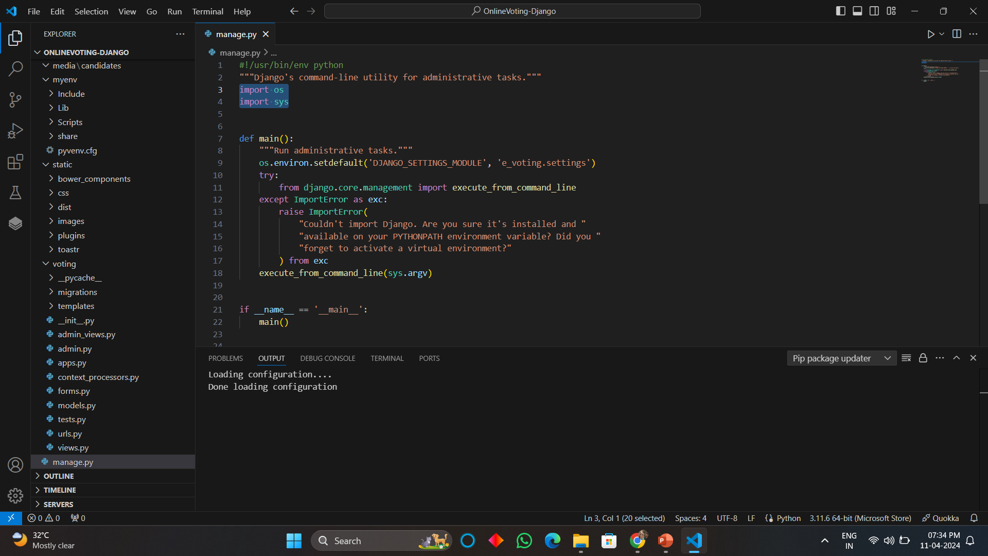
Homepage

Slide 12
About-Us-Page
1.Credibility:
The "About Us" page establishes credibility by providing information about the organization's history, mission, and team members
2.Mission and Values:
It communicates the organization's mission, values, and objectives in promoting democratic participation and decision-making.
3. Community Engagement:
The page showcases the organization's commitment to community engagement and empowerment through the voting process, inspiring active participation.
4. Contact Information:
Users can easily reach out with questions, feedback, or inquiries about the voting application through the contact information provided on the page.

Slide 13
Service-Page
Header Section
Introduction section
User Services
Administrator Services
Organizational Services
Technical Services
Consulting Services
Call to Action Services

Slide 14
Departments-Page
Header Section
Introduction Section
Department Listings
Department Details
Key Personnel
Collaboration Opportunities
Footer Section

Slide 15
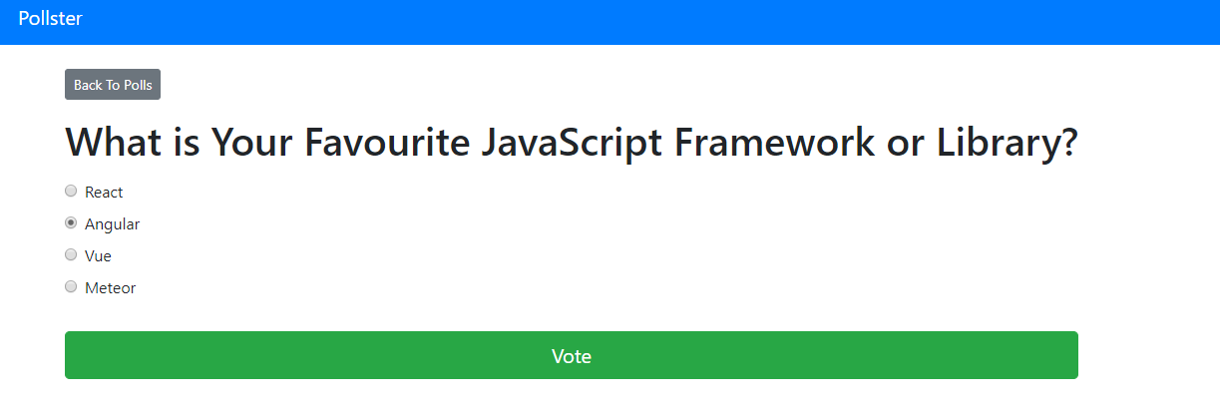
Blog-Page

Slide 16
Future Enhancements:
For future enhancements, the voting web application built on the Django framework could incorporate advanced features such as blockchain-based voting for enhanced security and transparency, integration with biometric authentication systems for secure user verification, and support for mobile voting applications to increase accessibility and participation. Additionally, implementing machine learning algorithms could improve the accuracy of result predictions and identify potential anomalies or irregularities in voting patterns. Furthermore, enhancing the user interface with interactive data visualization tools could provide users with deeper insights into voting trends and results. Overall, these enhancements would further elevate the voting web application's capabilities, ensuring its effectiveness, security, and inclusivity in democratic decision-making processes.

Slide 17
Conclusion
In conclusion, the voting web application developed using the Django framework represents a significant advancement in facilitating democratic decision-making processes. Through robust security measures, intuitive user interface design, and scalable architecture, the application provides a reliable platform for users to participate in voting events securely and transparently. The utilization of Django's built-in functionalities, coupled with potential future enhancements such as blockchain integration and machine learning algorithms, ensures the continuous evolution and effectiveness of the application in meeting the evolving needs of democratic societies. Overall, the voting web application stands as a testament to the power of technology in fostering inclusive and transparent governance, empowering citizens to actively engage in shaping their communities and societies.
Source :

Slide 18
Thank You!
Notes:
Thank You !!

